Slide 1
Consumer Credit Analysis Analyzing the past and predicting the future
ASU Data Analytics Boot Camp - Team 4
March 12, 2024
Presented by Ranil Joshua, Mark Mason, Qasim Khilji, Keith Allen

Slide 2
Industry:
Finance
Project objective:
The objective of this project is to develop a robust analytical model capable of understanding the dynamics of consumer credit.

Slide 3
Overview of the Project
Analyzing and predicting consumer credit trends.
The data is spanning from June 2000 to December 2023.
However, the prediction model is applied to the data from June 2000 to December 2022.
The 2023 data is left out to compare the results of the prediction.

Slide 4
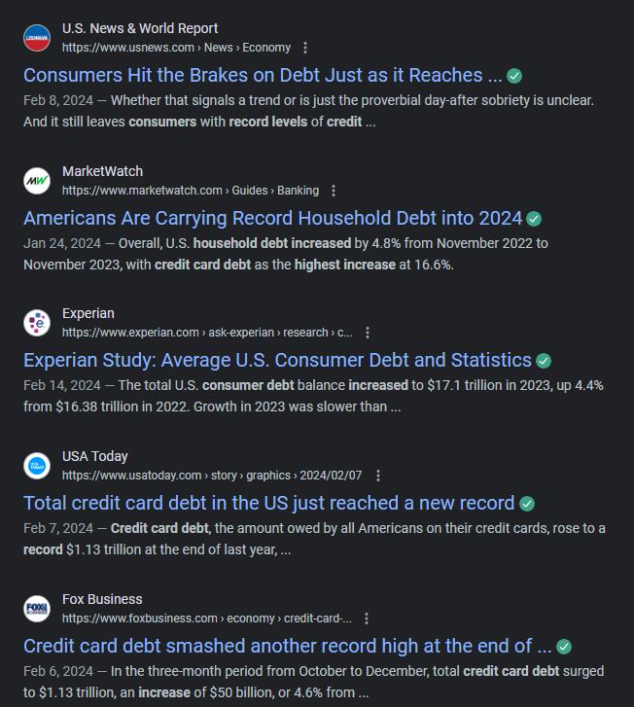
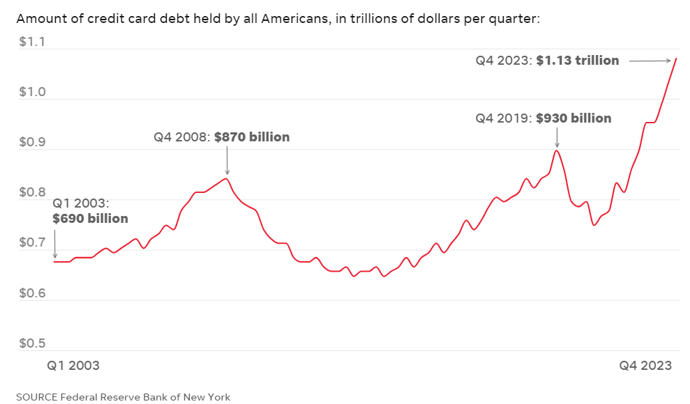
Background
Consumer Debt in the News...
Will historical data allow us to predict a dip, or are there indicators it will continue to rise?

Slide 5
Five Subcategories Of Consumer Debt
Mortgage Debt
Auto Loan Debt
Credit Card Debt
Student Loans
Other: Personal and Payday Loans, etc.
Dependents for the Predictions
Average Interest Rate
Election Year (yes/no)
Inflation Rate (monthly)
Unemployment Rate (monthly)

Slide 6
Datasets Used
Bureau of Labor Statistics Data
Unemployment Data
Consumer Credit - Data dot gov
Credit Owned Data
Consumer Credit Trends
Sub-categorical data like Mortgage, Auto and student loan, etc.
Federal Funds Rate
influences various aspects of the economy, including credit card interest rates, mortgage rates, and other consumer products.

Slide 7
Preprocessing the data
The data in CSV was formatted in Excel before we started analyzing the data in Python during this Preprocessing step.
Preprocessing is like preparing the ingredients before cooking. It makes sure everything is ready to be used effectively in the recipe—or in our case, the model!

Slide 8
Setting the environment / stage for the prediction
Setting Up the Environment:
Installed libraries such as PySpark and Java
We fetch our dataset via a URL link. This was done in PySpark.
Switched to using a Pandas DataFrame for convenience and familiarity.

Slide 9
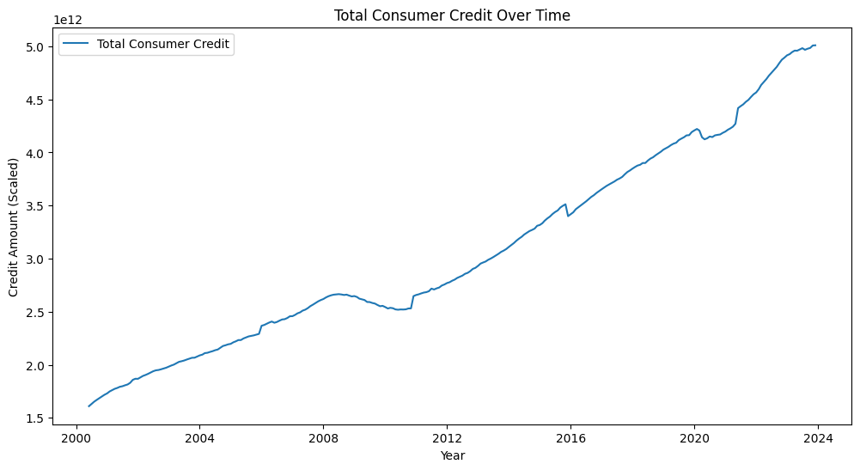
Exploratory Data Analysis (EDA)
EDA involves making sense of data trends through visualization.
The time series graph on the right shows how consumer credit has evolved.

Slide 10
Correlation matrix
We used the correlation matrix to find out the relationship between the Total consumer credit and other dependents as well as other subcategories of the consumer credit.
In the next slide, you will see a table we extracted from our analysis.

Slide 11
 | Total consumer credit owned and securitized, seasonally adjusted level | Interest Rate | Elections (yes/no) | Inflation Rate | Unemployment Rate | Motor Vehicle Loans Owned and Securitized | Credit Cards and Other Revolving Plans | Student loans | Mortgages | Other
Total consumer credit owned and securitized, seasonally adjusted level | 1 | -0.106731 | -0.096234 | 0.278921 | -0.277674 | 0.967375 | 0.945322 | -0.15469 | -0.185869 | 0.978206
Interest Rate | -0.106731 | 1 | 0.00078 | 0.411591 | -0.604145 | 0.032573 | -0.226161 | -0.15865 | -0.021835 | -0.10565
Elections (yes/no) | -0.096234 | 0.00078 | 1 | -0.010201 | 0.068749 | -0.099272 | -0.093867 | -0.088005 | -0.093079 | -0.067549
Inflation Rate | 0.278921 | 0.411591 | -0.010201 | 1 | -0.434618 | 0.393853 | 0.161393 | -0.314929 | -0.270081 | 0.300714
Unemployment Rate | -0.277674 | -0.604145 | 0.068749 | -0.434618 | 1 | -0.401735 | -0.142016 | 0.255689 | 0.147859 | -0.280096
Motor Vehicle Loans Owned and Securitized | 0.967375 | 0.032573 | -0.099272 | 0.393853 | -0.401735 | 1 | 0.865769 | -0.298322 | -0.285048 | 0.957337
Credit Cards and Other Revolving Plans | 0.945322 | -0.226161 | -0.093867 | 0.161393 | -0.142016 | 0.865769 | 1 | -0.068335 | -0.124787 | 0.888453
Student loans | -0.15469 | -0.15865 | -0.088005 | -0.314929 | 0.255689 | -0.298322 | -0.068335 | 1 | 0.91979 | -0.288114
Mortgages | -0.185869 | -0.021835 | -0.093079 | -0.270081 | 0.147859 | -0.285048 | -0.124787 | 0.91979 | 1 | -0.341328
Other | 0.978206 | -0.10565 | -0.067549 | 0.300714 | -0.280096 | 0.957337 | 0.888453 | -0.288114 | -0.341328 | 1

Slide 12

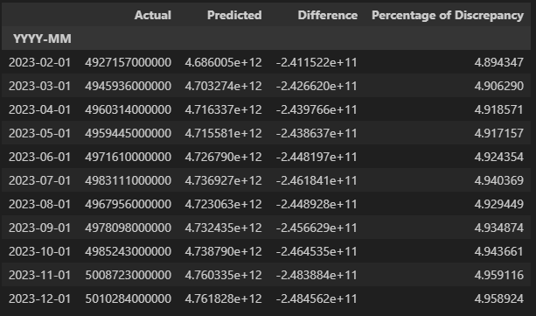
Analysis Results
Normalized features using StandardScaler
Used a Linear Regression model
Trained the model using data prior to 2023, and tested it on data from 2023
Compared the predicted data with actual data
R-squared value = 0.9855801997414367

Slide 13
Impacts of different features
Used coefficients from linear regression model and mapped them to the different features to determine impacts:
{'Interest Rate': -0.000652273086771723, 'Elections (yes/no)': -0.000244140625, 'Inflation Rate': -3.0517578125e-05, 'Unemployment Rate': -0.000732421875, 'Motor Vehicle Loans Owned and Securitized': 227859742057.17444, 'Credit Cards and Other Revolving Plans': 220316388370.26282, 'Student loans': 5894479882.94339, 'Mortgages': 89403943591.27307, 'Other': 450673606701.9846}

Slide 14
Future Steps
Investigate why Interest, Inflation, and Unemployment Rates did not have higher impact
Look deeper into Election Cycles
Pull out more features to train the model and determine impacts, such as:
Demographic Trends
Technology and Innovation
Cultural and Social Factors

Slide 15
Questions / Comments?

